Slide 1
Chapter 7 Single-Dimensional Arrays

Slide 2
Opening Problem
Read one hundred numbers, compute their average, and find out how many numbers are above the average.

Slide 3
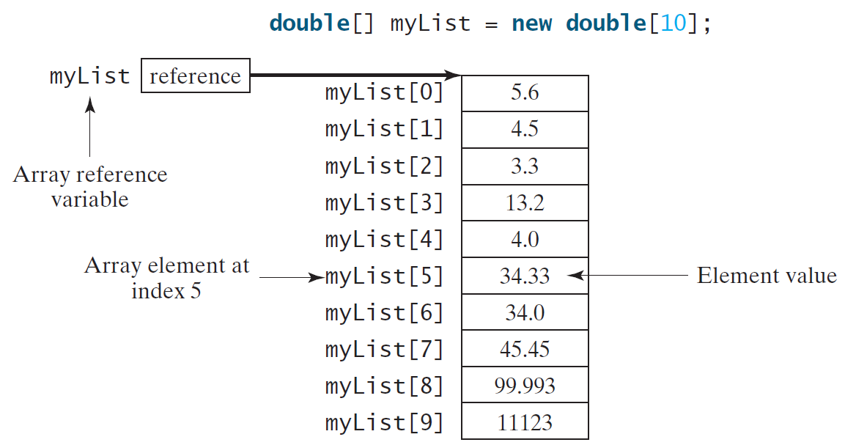
Introducing Arrays
Array is a data structure that represents a collection of the same types of data.

Slide 4
Declaring Array Variables
datatype[] arrayRefVar;
Example:
double[] myList;

Slide 5
Creating Arrays
arrayRefVar = new datatype[arraySize];
Example:
myList = new double[10];
myList[0] references the first element in the array.
myList[9] references the last element in the array.

Slide 6
Declaring and Creating in One Step
datatype[] arrayRefVar = new
datatype[arraySize];
double[] myList = new double[10];

Slide 7
The Length of an Array
Once an array is created, its size is fixed. It cannot be changed. You can find its size using
arrayRefVar.length
For example,
myList.length returns 10

Slide 8
Default Values
When an array is created, its elements are assigned the default value of
0 for the numeric primitive data types,
'\u0000' for char types, and
false for boolean types.

Slide 9
Indexed Variables
The array elements are accessed through the index. The array indices are 0-based, i.e., it starts from 0 to arrayRefVar.length-1. In the example in Figure 6.1, myList holds ten double values and the indices are from 0 to 9.
Each element in the array is represented using the following syntax, known as an indexed variable:
arrayRefVar[index];

Slide 10
Using Indexed Variables
After an array is created, an indexed variable can be used in the same way as a regular variable. For example, the following code adds the value in myList[0] and myList[1] to myList[2].
myList[2] = myList[0] + myList[1];

Slide 11
AnalyzeNumbers.java
Page 257 Listing7.1

Slide 12
Array Initializers
Declaring, creating, initializing in one step:
double[] myList = {1.9, 2.9, 3.4, 3.5};
This shorthand syntax must be in one statement.

Slide 13
Declaring, creating, initializing Using the Shorthand Notation
double[] myList = {1.9, 2.9, 3.4, 3.5};
This shorthand notation is equivalent to the following statements:
double[] myList = new double[4];
myList[0] = 1.9;
myList[1] = 2.9;
myList[2] = 3.4;
myList[3] = 3.5;

Slide 14
CAUTION
Using the shorthand notation, you have to declare, create, and initialize the array all in one statement. Splitting it would cause a syntax error. For example, the following is wrong:
double[] myList;
myList = {1.9, 2.9, 3.4, 3.5};

Slide 15
Initializing arrays with input values
java.util.Scanner input = new java.util.Scanner(System.in);
System.out.print("Enter " + myList.length + " values: ");
for (int i = 0; i < myList.length; i++)
myList[i] = input.nextDouble();

Slide 16
Initializing arrays with random values
for (int i = 0; i < myList.length; i++) {
myList[i] = Math.random() * 100;
}

Slide 17
Printing arrays
for (int i = 0; i < myList.length; i++) {
System.out.print(myList[i] + " ");
}

Slide 18
Summing all elements
double total = 0;
for (int i = 0; i < myList.length; i++) {
total += myList[i];
}

Slide 19
Finding the largest element
double max = myList[0];
for (int i = 1; i < myList.length; i++) {
if (myList[i] > max) max = myList[i];
}

